Slide 1

Milestone 3 - RadarID
Radar-Based User Identification in Smart Environments
TEAM 5
Francisco Gonçalves
Guilherme Santos
Hugo Rodrigues
João Gaspar
Ricardo Dias
Sérgio Correia
Supervised by Dr.ª Ana Rocha, Prof. Samuel Silva
PECI – 2023/2024

Slide 2
Context
Today there’s more smart environments, equipped with sensors that collect data.
However, this data collection raises privacy and consent concerns.
It is necessary to establish ethical standards and legal frameworks to ensure the responsible and transparent use of the data collected.
Notes:
Hoje em dia todos nós penso que concordamos

Slide 3
Objective
Develop a radar-based solution for human identification, in the context of smart environments, such as smart homes.
Online identification of a single person from a set of registered users
Proof-of-concept for smart home applications
Personalized automation
Security
3

Slide 4
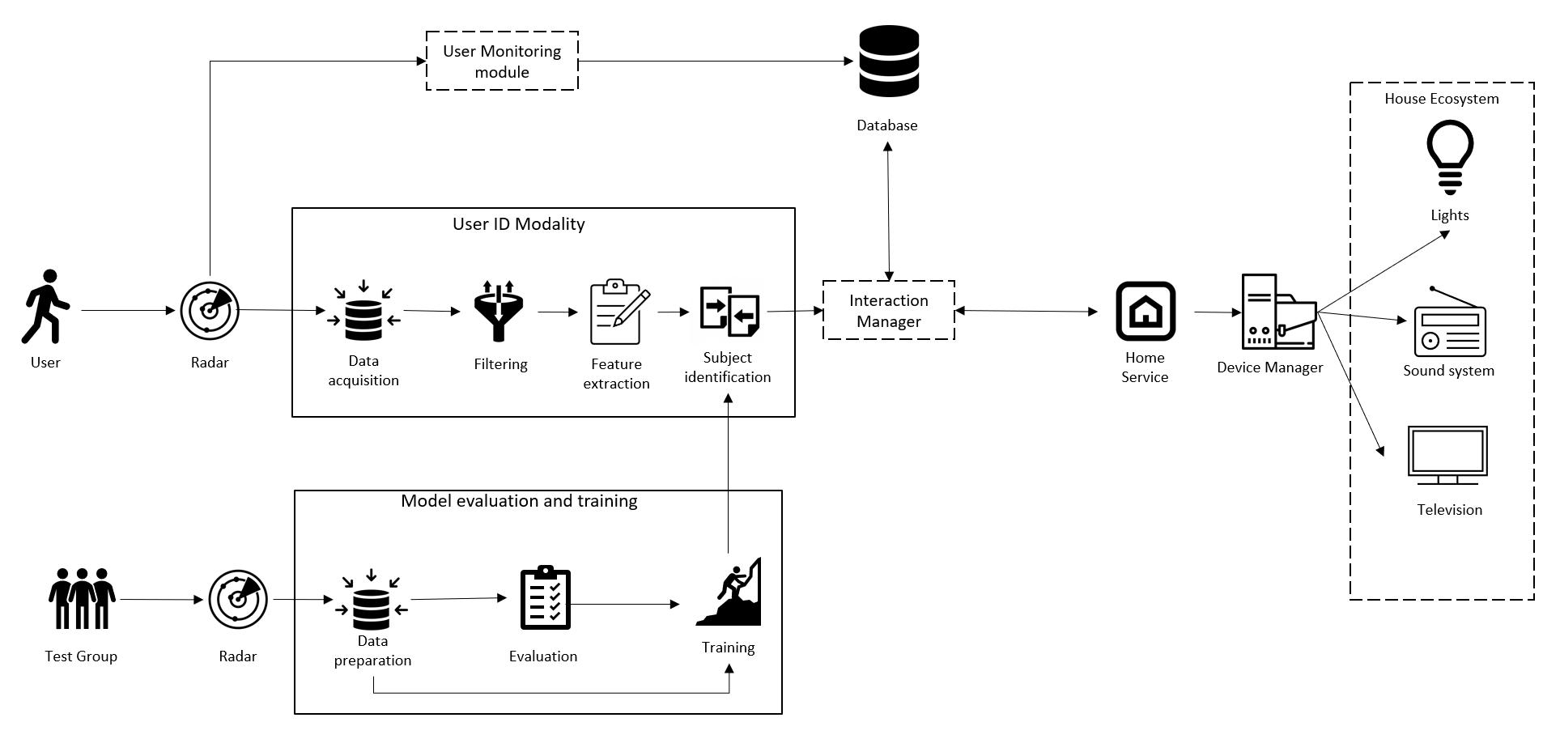
Architecture
4

Slide 5
USER ID MODALITY
The Data Acquisition Module receives raw radar data, performs the parcing of TLV packages, creates a JSON file and forwards it to the Filtering Module.
The Filtering Module then processes and removes noise from the data.
Data Acquisition
Filtering
Feature Extraction
Subsequently, the file is sent to the Feature Extraction Module, responsible for extracting multiple features of different types of data.
Subject Identification
The generated features are used as input for the Subject Identification Module, which consists of a model that identifies the current user.

Slide 6
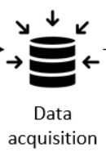




Data Acquisition
Serial Configuration
Establishes communication with radar ports for setup and data retrieval
Data Acquisition
Receives and parses incoming data to extract relevant information such as object position and velocity

Slide 7

Filtering
The Data Filtering Module filters raw radar data by removing noise.
Sliding Window Operation
The module sequentially analyzes radar data using a sliding window approach, where the size and overlap can be configured.
Doppler-Based Filtering
Doppler velocity is calculated for each data point. Data points with Doppler velocity below 1e-5 m/s will be excluded.

Slide 8

Feature Extraction
The module extracts a feature from the radar data for each time window.
Data type features:
For each data type, we extract its features and calculate histograms, resulting in a 2D histogram ('matrix') based on the elapsed time and radar data values it represents the frequency of occurrence of radar data values within specific time intervals.
Feature Matrix
It concatenates all of the matrices from the last step and creates an final matrix.
Grey Image
The final data matrix values are converted into a grayscale image and saved as a PNG file.

Slide 9
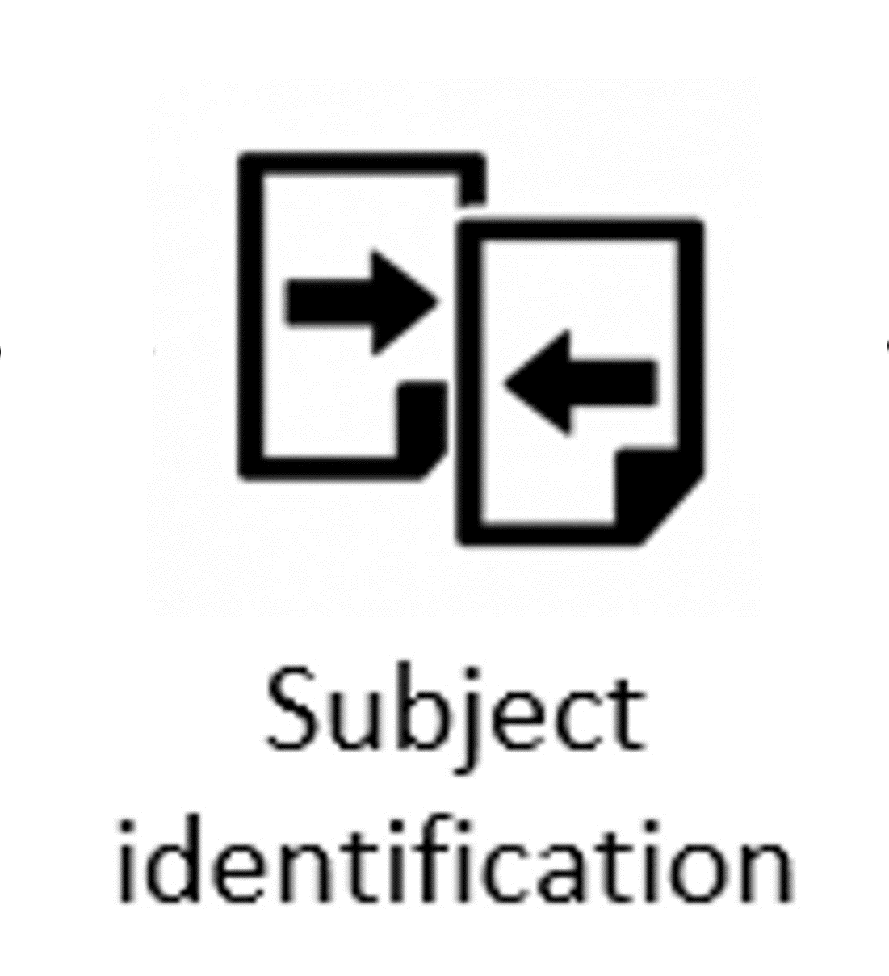
Subject Identification
The Subject Identification Module is currently under development. We will work on:
Machine Learning
We aim to develop a model that will be trained on a dataset of radar data collected from multiple individuals. By analyzing these radar signatures, the model will learn to identify patterns, leveraging transfer learning to retrain a pre-trained model using a smaller dataset consisting of features extracted from the radar data.
When completed the module will be responsible for getting an ID of a list of ID's using the model and the extracted feature as base.

Slide 10



Online Pipeline
The User ID Modality leverages MQTT and Mosquitto for online communication between the various modules, allowing them to be deployed in different computing units if needed.​

Slide 11
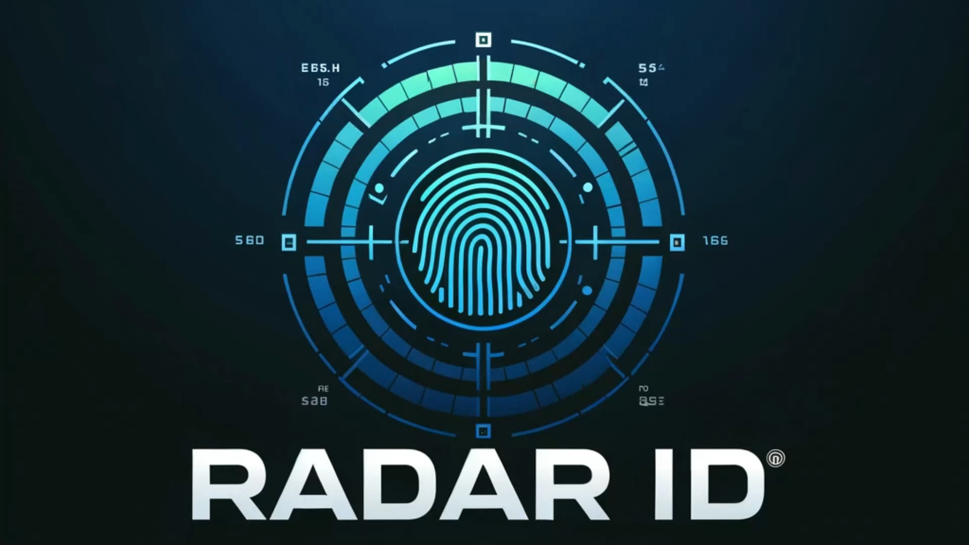
Demonstration

Slide 12

Next steps
Multiple tests to develop the model for subject identification, enabling us to build the Subject Identification Module
This entails different aspects:
Data acquisition planning (setup, protocol, …)
Offline data collection from subjects
Dataset generation
Model evaluation (transfer learning)

Slide 13
THANK YOU!

